Slide 1

Digital Portfolio
STUDENT NAME: DIVYA K
REGISTER NO AND NMID:2401111033006/asunm1112401111033006
DEPARTMENT: COMPUTER APPLICATION
COLLEGE: L.N.Govt. College / Madras University.

Slide 2
PROJECT TITLE
AI-Powered Smart Portfolio for Career Growth

Slide 3

AGENDA
1.Problem Statement
2.Project Overview
3.End Users
4.Tools and Technologies
5.Portfolio design and Layout
6.Features and Functionality
7.Results and Screenshots
8.Conclusion
9.Github Link
3/21/2024 Annual Review

Slide 4
PROBLEM STATEMENT
Traditional student portfolios often lack interactivity, personalization, and accessibility. Employers and institutions find it difficult to assess skills beyond academic scores.

Slide 5
PROJECT OVERVIEW
The project focuses on creating a digital portfolio platform where students can showcase their academic, technical, and creative skills in a professional manner. The platform integrates projects, achievements, certifications, and GitHub repositories into a single interactive interface.

Slide 6
WHO ARE THE END USERS?
Students (to showcase their skills) Recruiters (to evaluate potential candidates) Institutions (for academic and placement purposes)

Slide 7
TOOLS AND TECHNIQUES
Frontend: HTML, CSS, JavaScript / React Backend: Node.js / Django Database: MySQL / MongoDB Version Control: Git & GitHub Design Tools: Figma / Canva

Slide 8
PORTFOLIO DESIGN AND LAYOUT
Minimalistic & professional theme Responsive web design (mobile & desktop) Organized sections: About, Skills, Projects, Certifications, Contact
8

Slide 9
FEATURES AND FUNCTIONALITY
Dynamic project showcase with images/screenshots Integrated GitHub & LinkedIn links Downloadable Resume option Contact form with email integration Responsive, user-friendly interface

Slide 10
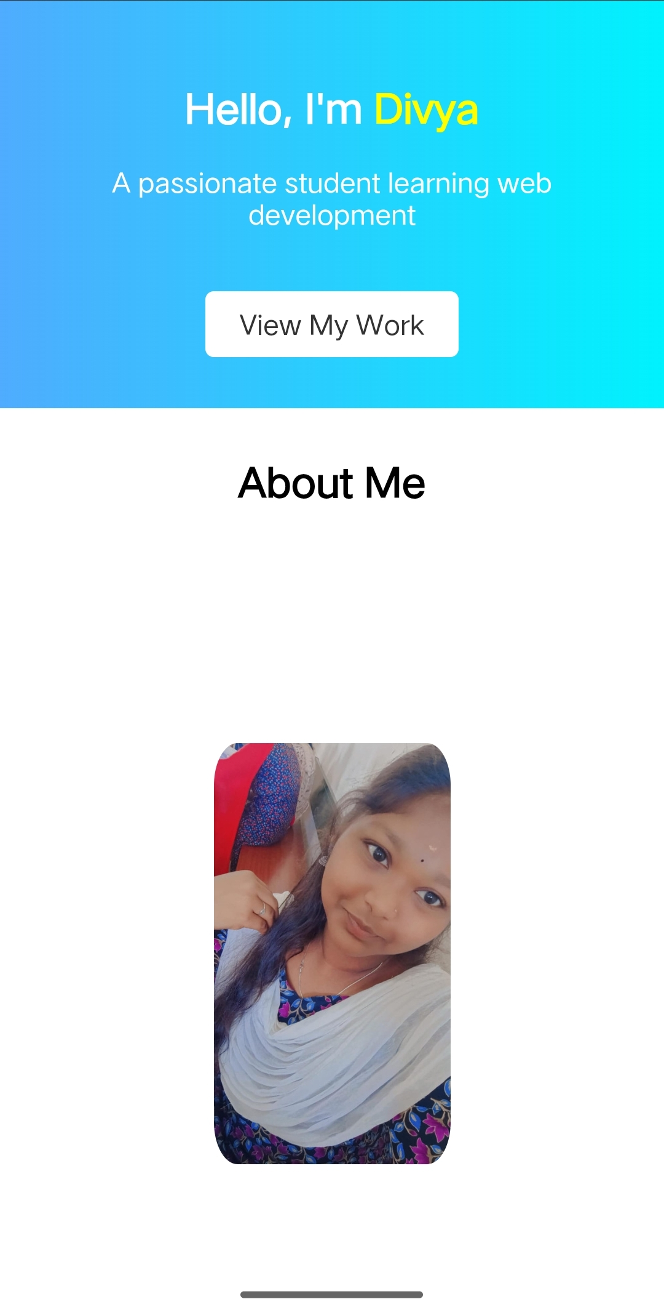
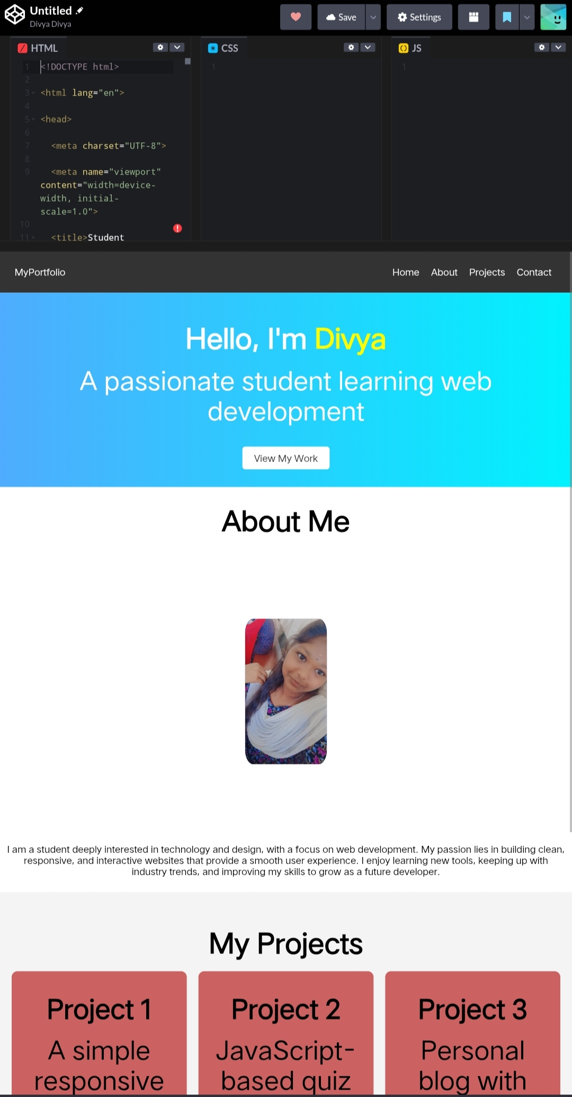
RESULTS AND SCREENSHOTS
3/21/2024 Annual Review
10

Slide 11
Github Link
https://divya033006.github.io/Profile/

Slide 12
CONCLUSION
The digital portfolio enhances visibility, accessibility, and professionalism. It helps students present their skills effectively and provides recruiters with structured insights.
12

